Slide 1



Analysis payLOCATOR – Tableau
Edgar Tomé
JUN, 20th | PARIS
DAFT MAY2022

Slide 2


Business case
Domain
Bank transations with servisse payLOCATOR
Problem
Analys the key performance indicators for transations system betewn banks.

Slide 3
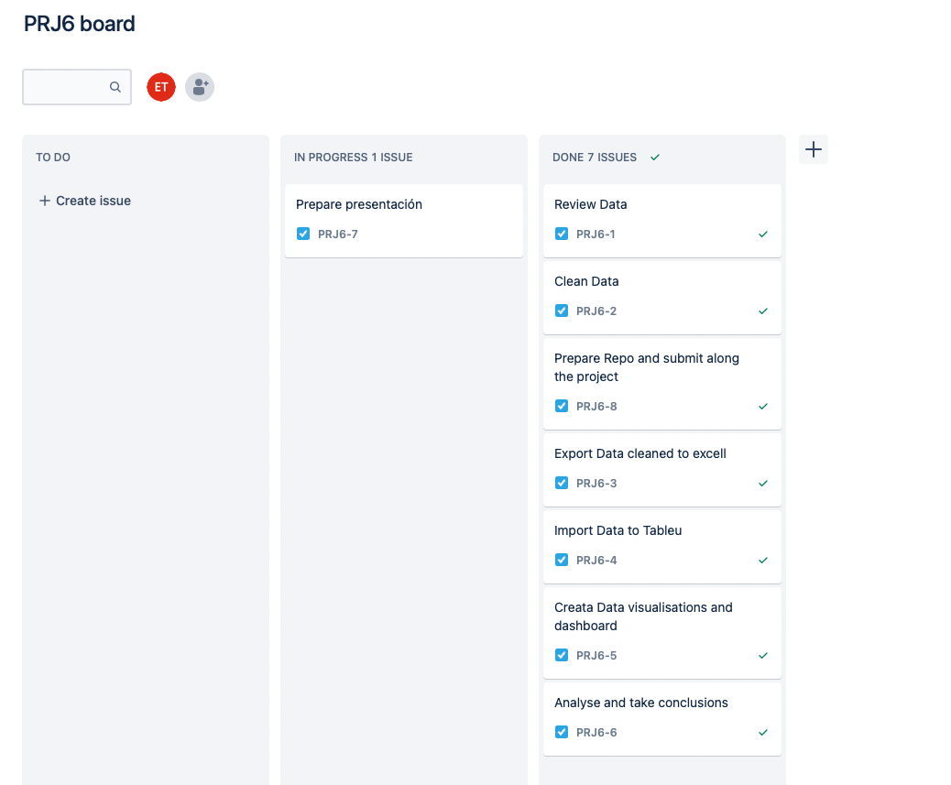
Plan
Review data and business case study
Clean data
Analyse data in excel
Export data for Tableau
Perform analyse of key performance indicators with widgets
Present conclusions on dashboard.

Slide 4
Project Description
The aim of this project was to practice descriptive and prescriptive statistics, to presented in dashboards creation with Tableau.
Project Goal
The goals of this project was to develop the dashboard in Tableau, that reflects the descriptive and predictive analysis of data and explain the state of the payments for PayLocator of SWIFT.

Slide 5
Data cleaning
The data cleaning and exploratory data analysis process, was to:
Uniform the date values of transitions.
Retrieve information of the country's by code of the banks.
Codifying with key value for each unique transaction.
Remove Nan values and miss spelling.

Slide 6
Data preparation
In excel, prepared the data to be uploaded in Tableau:
Calculation of steps taken by transitions to be completed.
Calculation od days and hours taken by transitions.
Calculation of charges applied by the banks for each transition.

Slide 7
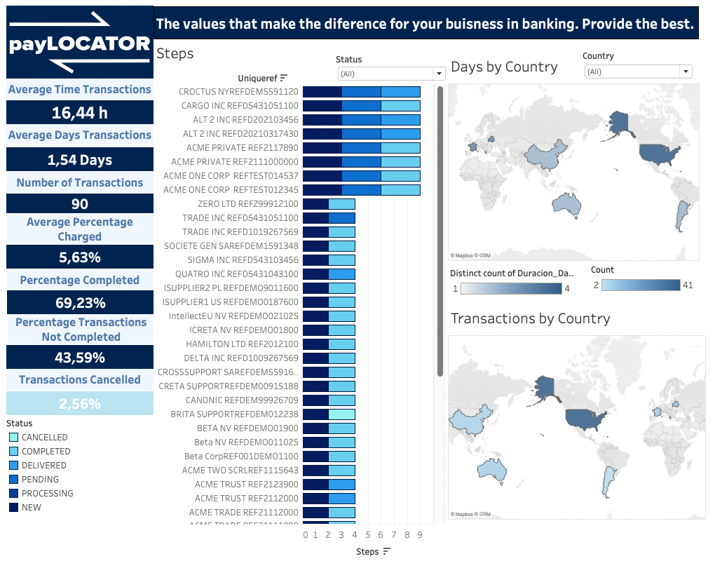
Exploratory Data in Tableau
Indicators in all dashboards
Average time
Average days
Number of transactions
Average Percentage Charged
Percentage Completed
Percentage Not Completed
Transactions Cancelled

Slide 8
Exploratory Data in Tableau
First Dashboard
Steps for transaction
Days by country
Transactions by country

Slide 9
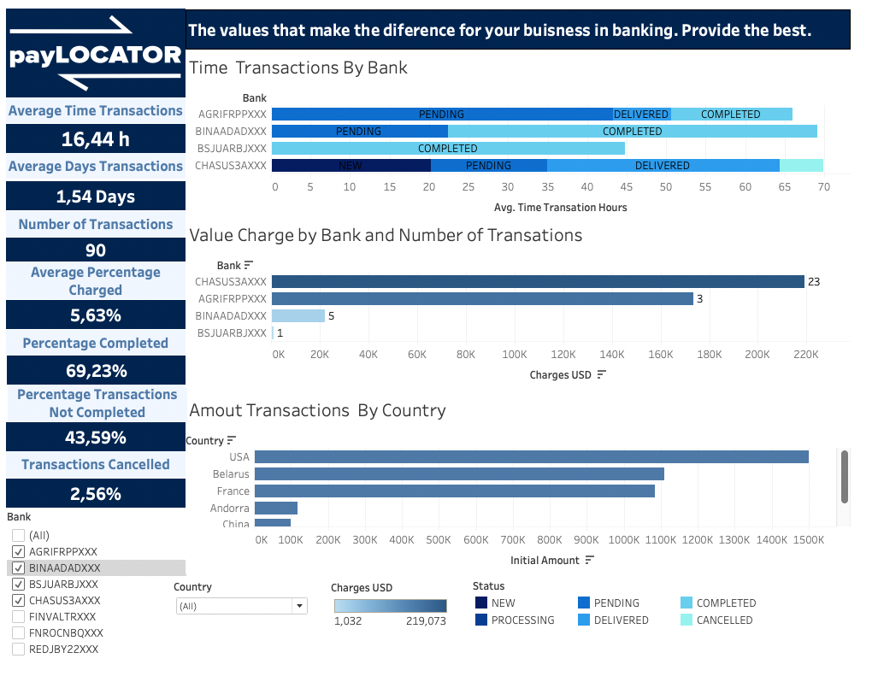
Exploratory Data in Tableau
Secound Dashboard
Time transactions by bank
Value charge by bank and number of transactions
Amount transactions by country

Slide 10
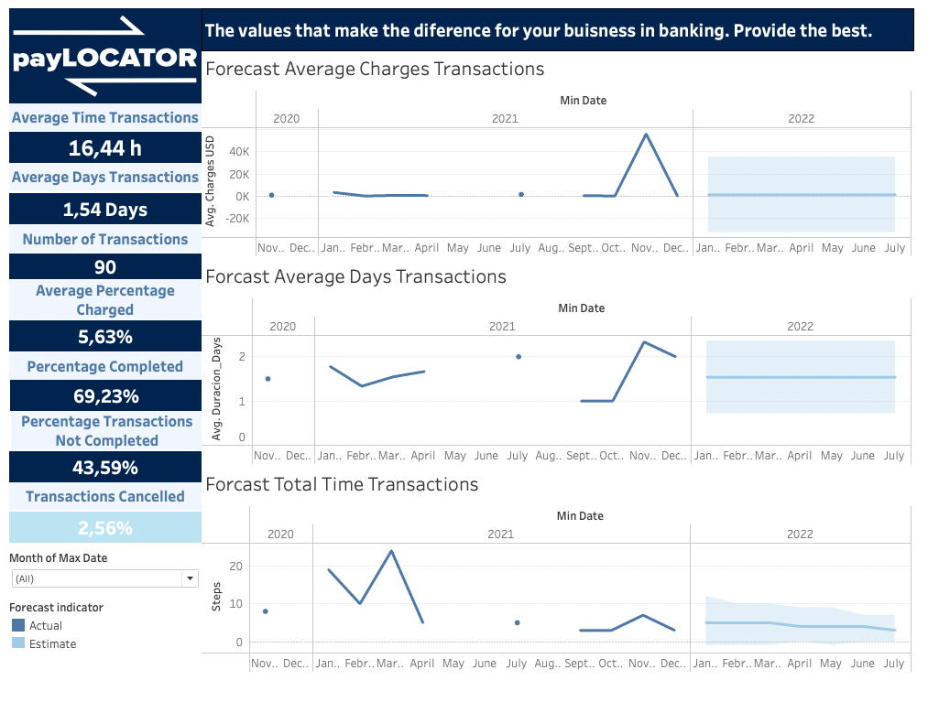
Exploratory Data in Tableau
Theird Dashboard
Forecast
Average charges transactions
Average days transactions
Total time transactions

Slide 11
Conclusions
From the data collected and the analysis perform first in excel and then in Tableau with visualizations, we can conclude that the service, can provide transactions around the world in less that two days in average.
For that premium service the percentage of charges are very high, taking in consideration that the transactions not completed are very high as well, the company should try to find the problem and fixed.
The country with more transitions, more value of transactions is the USA.
To realize a better forecast, is necessary more data for a bigger period of time.

Slide 12
Analysis payLOCATOR – Tableau
Edgar Tomé
Questions?
Merci

